Slide 1
Introduction to jQuery
Presented by: Manal Asghar

Slide 2
What is jQuery?
jQuery is a fast, lightweight JavaScript library.
Purpose:
“Write Less, Do More”
It simplifies:
DOM manipulation
Event handling
Animations
AJAX
Before jQuery:
JavaScript was long & complex.

Slide 3

Why jQuery Was Popular?
Cross-browser compatibility
Easy syntax
Shorter code
Simple animations
Easy DOM access
Example:
JavaScript:
jQuery:

Slide 4
jQuery Syntax
jQuery Syntax
Basic Syntax:
$(selector).action();
$ → jQuery
selector → HTML element
action() → What to do
Example:
$("#btn").click(function(){
alert("Button Clicked");
});

Slide 5
jQuery Selectors
Selector | Meaning
$("p") | Select all paragraphs
$("#id") | Select by ID
$(".class") | Select by class
$("div p") | Select p inside div
$("input:first") | First input

Slide 6

jQuery Events
jQuery has built-in animation effects:
hide()
show()
toggle()
fadeIn()
fadeOut()
slideDown()
slideUp()
Example:
1000 = 1 second animation

Slide 7

DOM Manipulation
DOM = Document Object Model
jQuery can:
Change text → .text()
Change HTML → .html()
Change CSS → .css()
Add class → .addClass()
Remove class → .removeClass()

Slide 8
jQuery Mobile Basics
It is a mobile UI framework built on jQuery.
Features:
Touch-friendly UI
Mobile themes
Responsive layout
Swipe events
Note:
jQuery Mobile is now outdated but still taught academically.

Slide 9
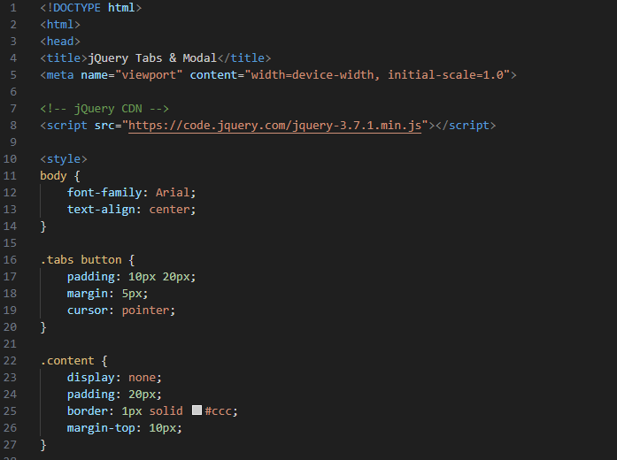
Tabbed Content + Modal Using jQuery

Slide 10
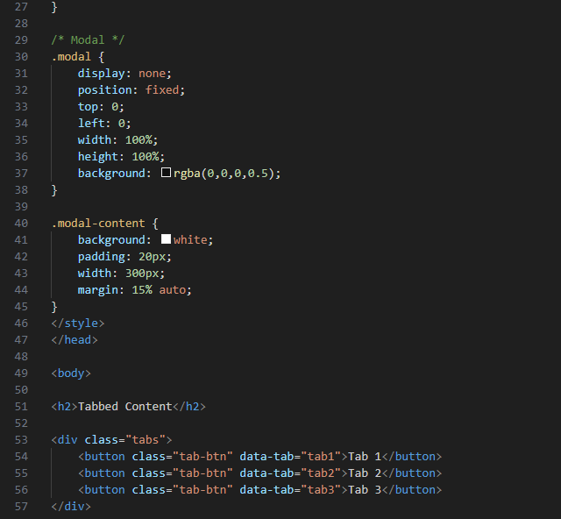
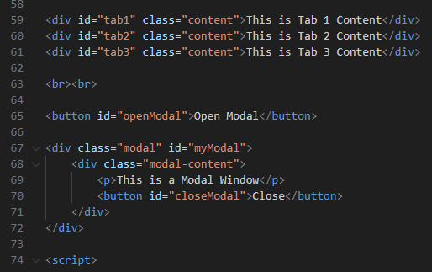

Slide 11
